Slide 1
Citizen Science 2 - Data
Module Learning Outcomes:
Knowledge and understanding
1. Demonstrate critical awareness of the rapidly changing status of species in the natural environment, the implications for ecosystem services, and the approaches to addressing these problems in different ecosystems.
Intellectual, practical, affective and transferable skills
3. Critically assess conservation issues and communicate scientific arguments to a wide audience.

Slide 2
Citizen Science 2 - Data
Part i
NBN Atlas
GBIF
Part ii
Country-based biodiversity portals
Other useful data sources
Part iii
Global citizen science projects
Research from citizen science

Slide 3
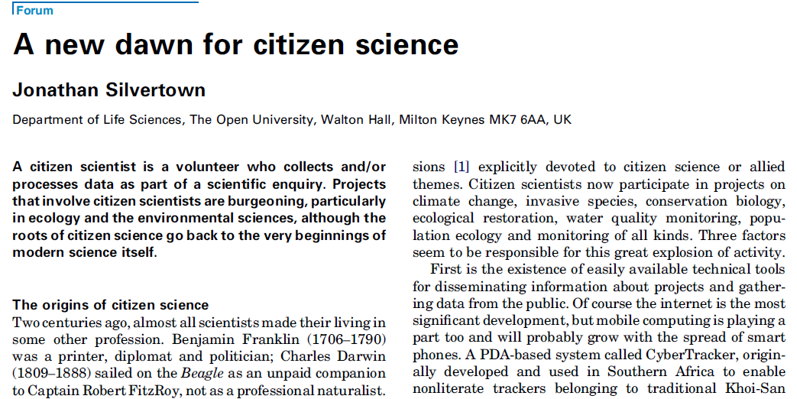
TREE 24 (9): 467-471
Notes:
Silvertown, J., 2009. A new dawn for citizen science. Trends in ecology & evolution, 24(9), pp.467-471.

Slide 4
National Biodiversity Network (NBN) Atlas

Slide 5

National Biodiversity Network (NBN) Atlas
nbnatlas.org
Portal for viewing UK (& some Ireland) species data
Over 200 million species records...
...from over 900 datasets (sources)
plants
animals
fungi
Notes:
http://data.nbn.org.uk/

Slide 6
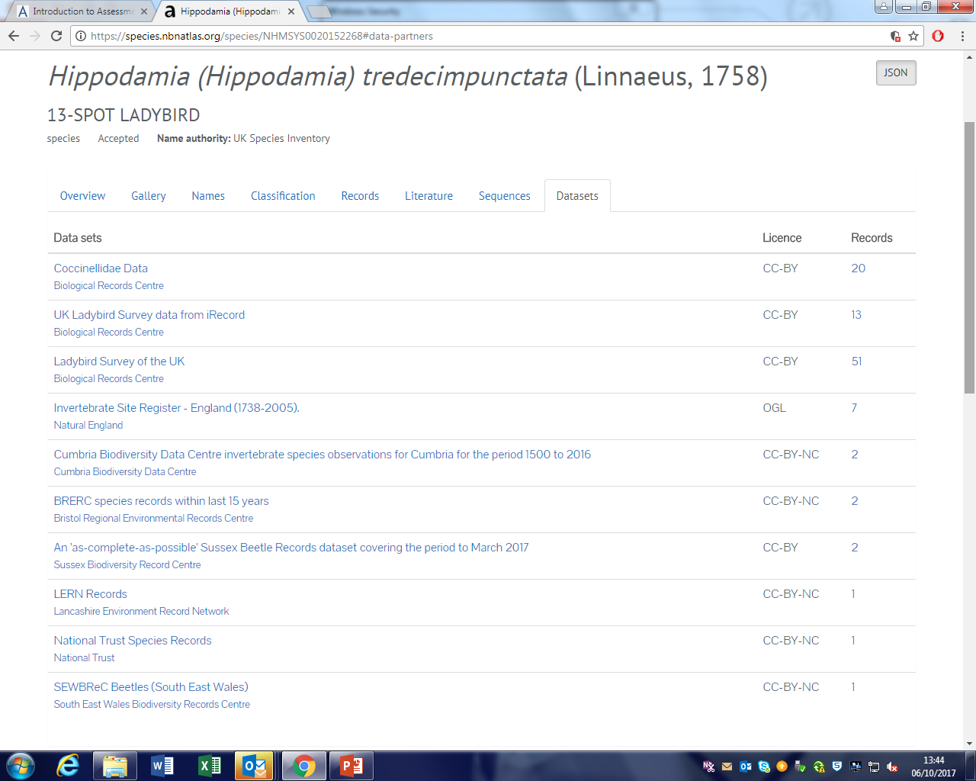
Finding datasets for your assignment
nbnatlas.org

Slide 7
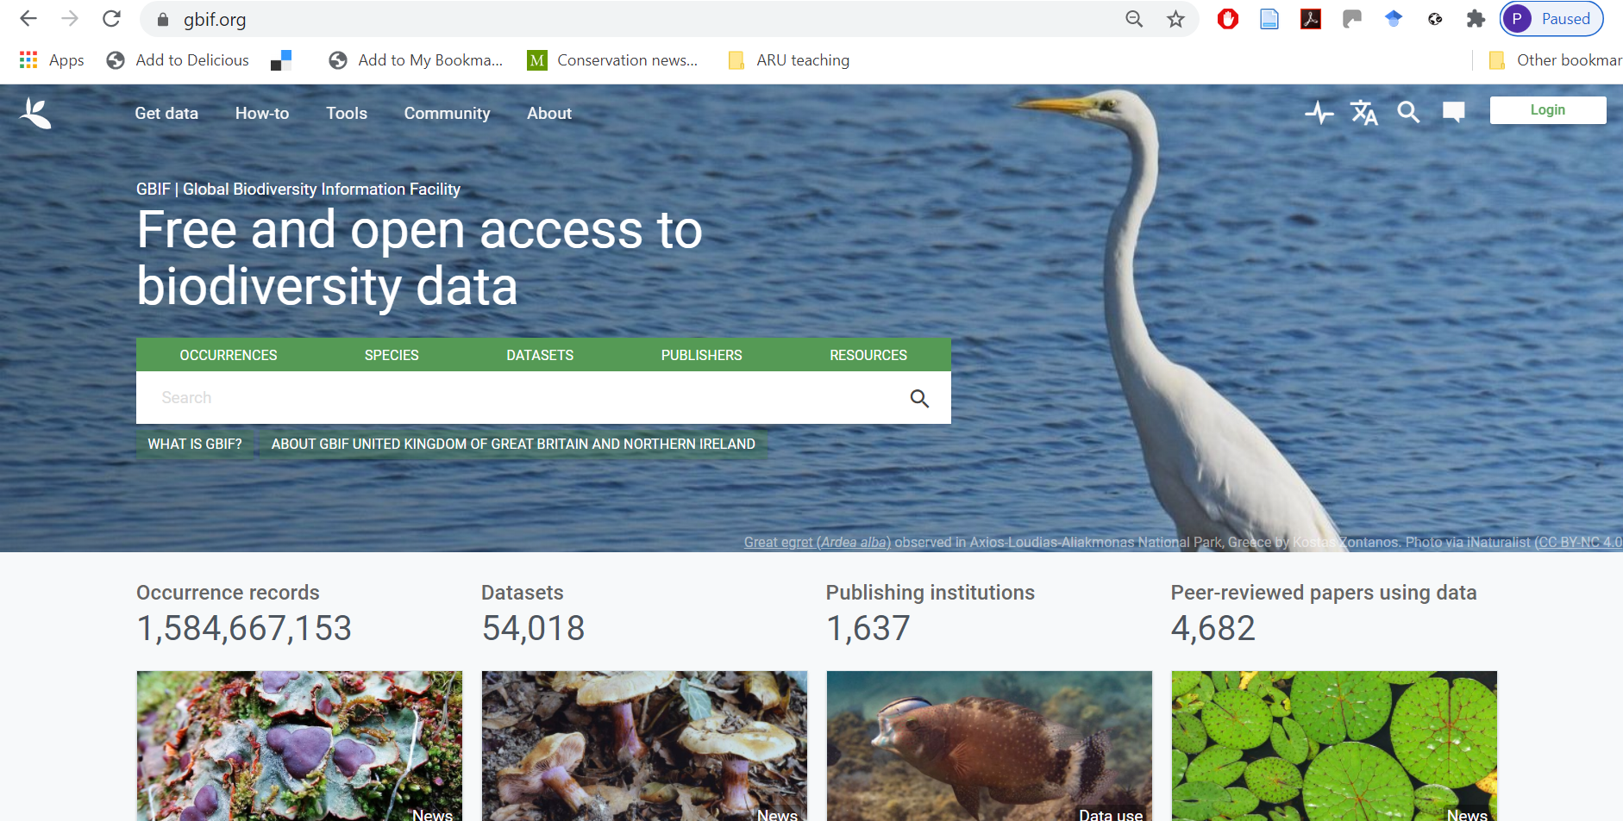
Global Biodiversity Information portal (GBIF)

Slide 8
GBIF
Can search by
Occurrences
then lots of filters available, e.g. by years and regions
Species
Datasets
e.g. search by country
Trends
gives summary trends for countries by time, taxa, etc

Slide 9
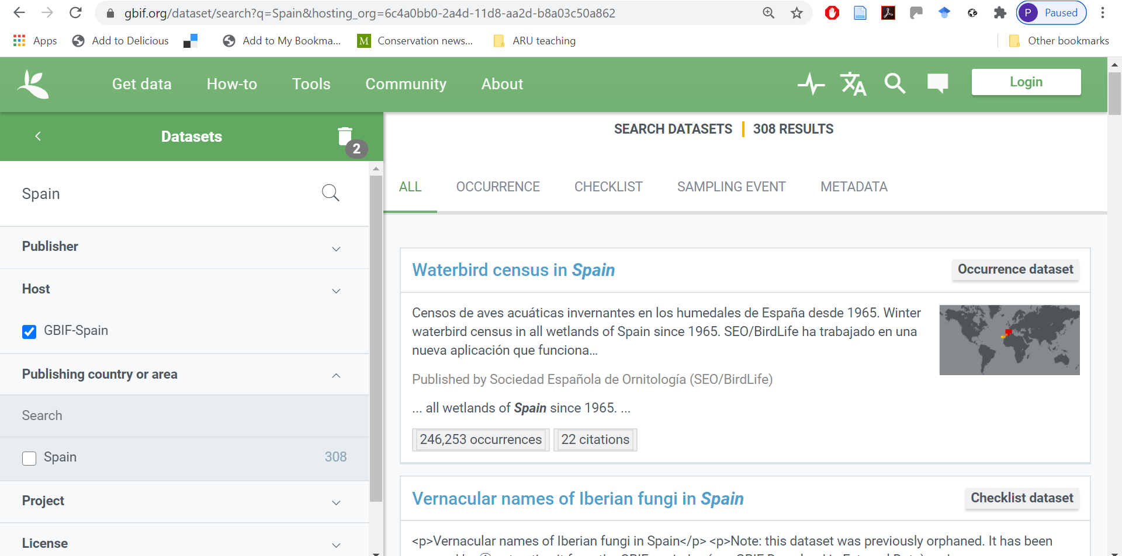
GBIF – e.g. by country (Spain)

Slide 10
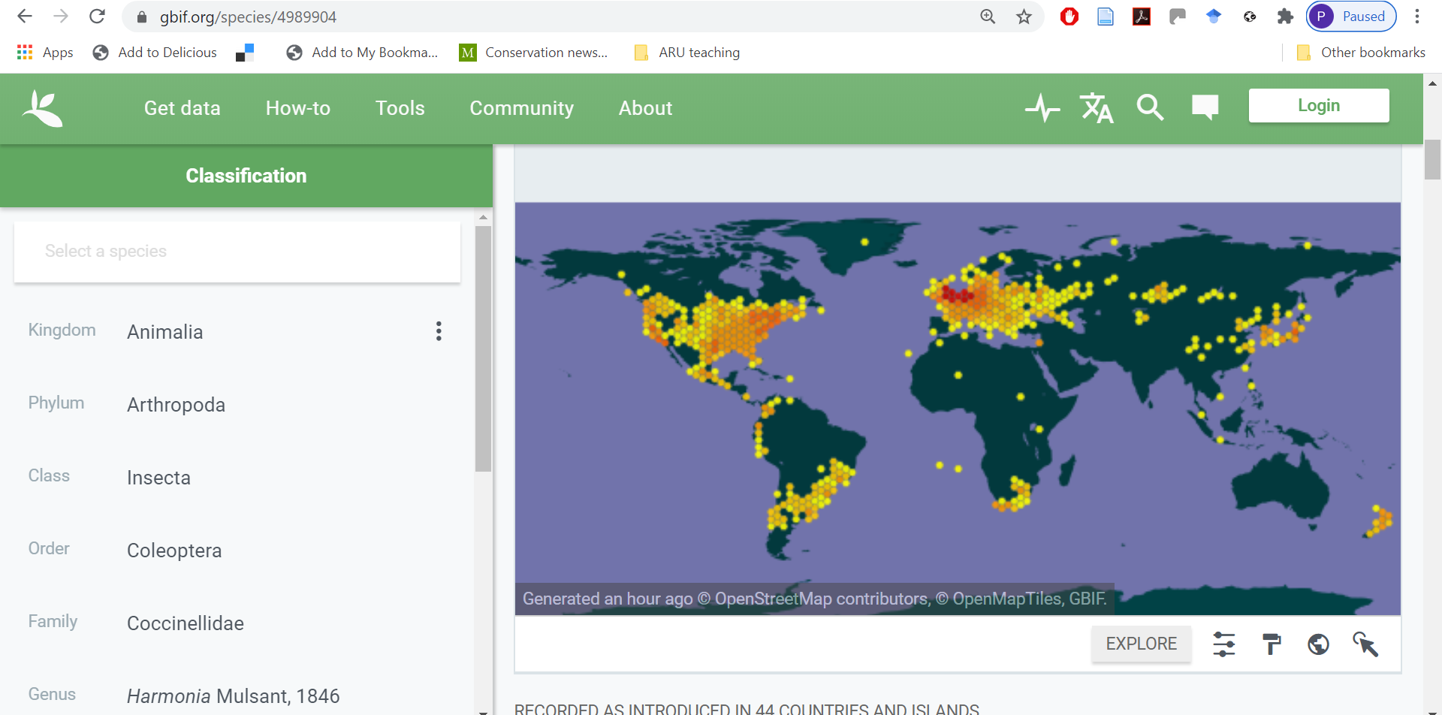
GBIF – e.g. by species
Notes:
https://www.gbif.org/species/4989904

Slide 11
Citizen Science 2 - Data
Part i
NBN Atlas
GBIF
Part ii
Country-based biodiversity portals
Other useful data sources
Part iii
Global citizen science projects
Research from citizen science

Slide 12
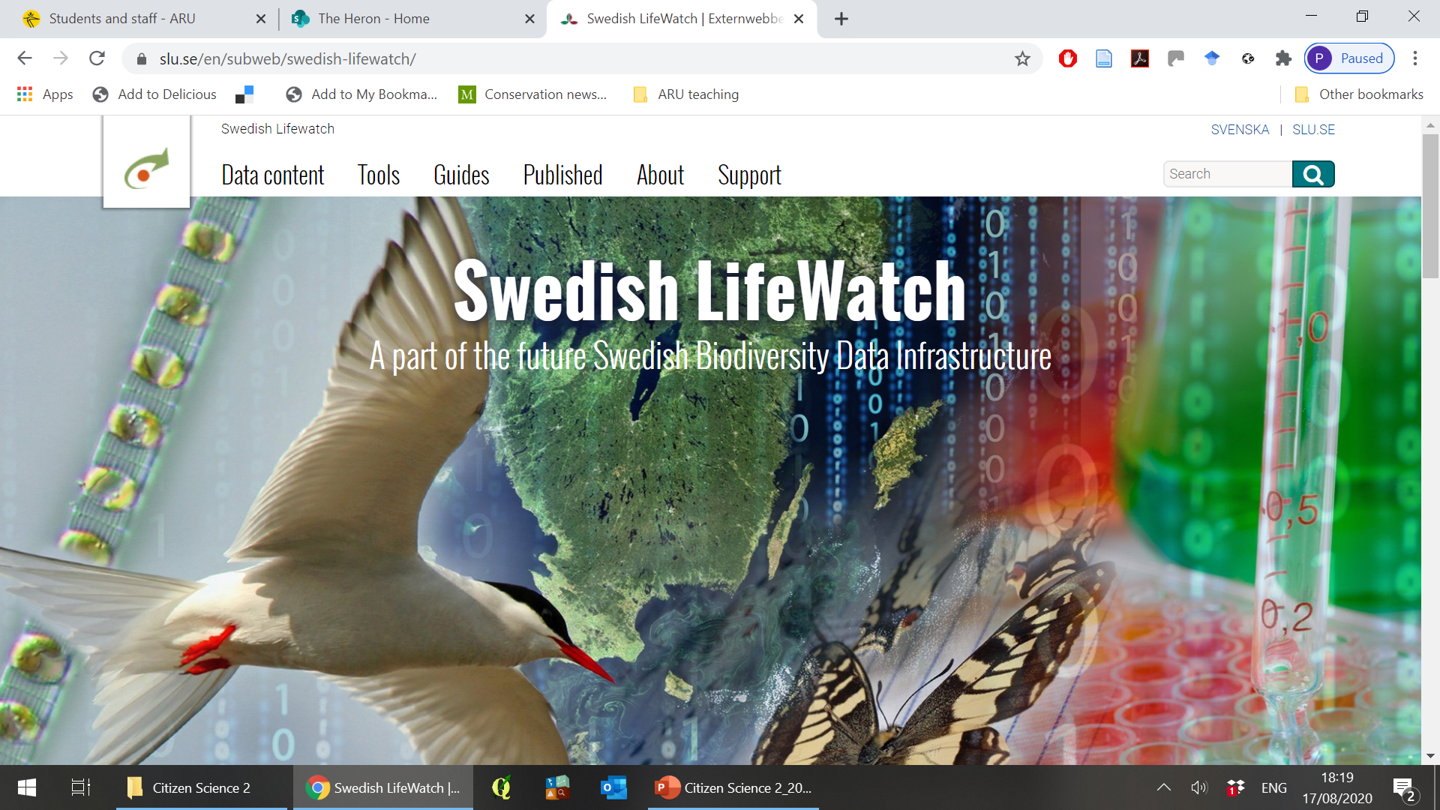
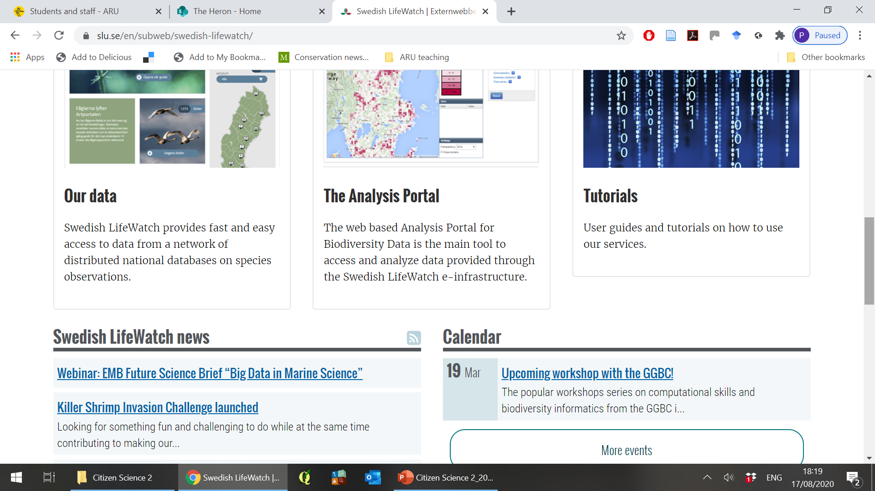
Sweden - www.slu.se/en/subweb/swedish-lifewatch/

Slide 13
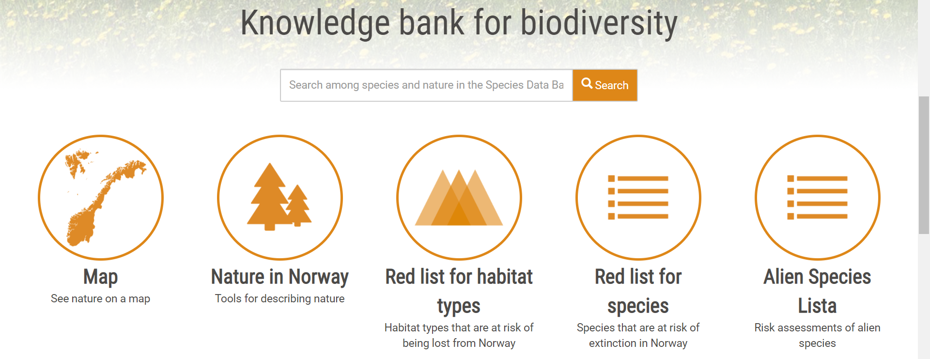

Norway - www.artsdatabanken.no/

Slide 14
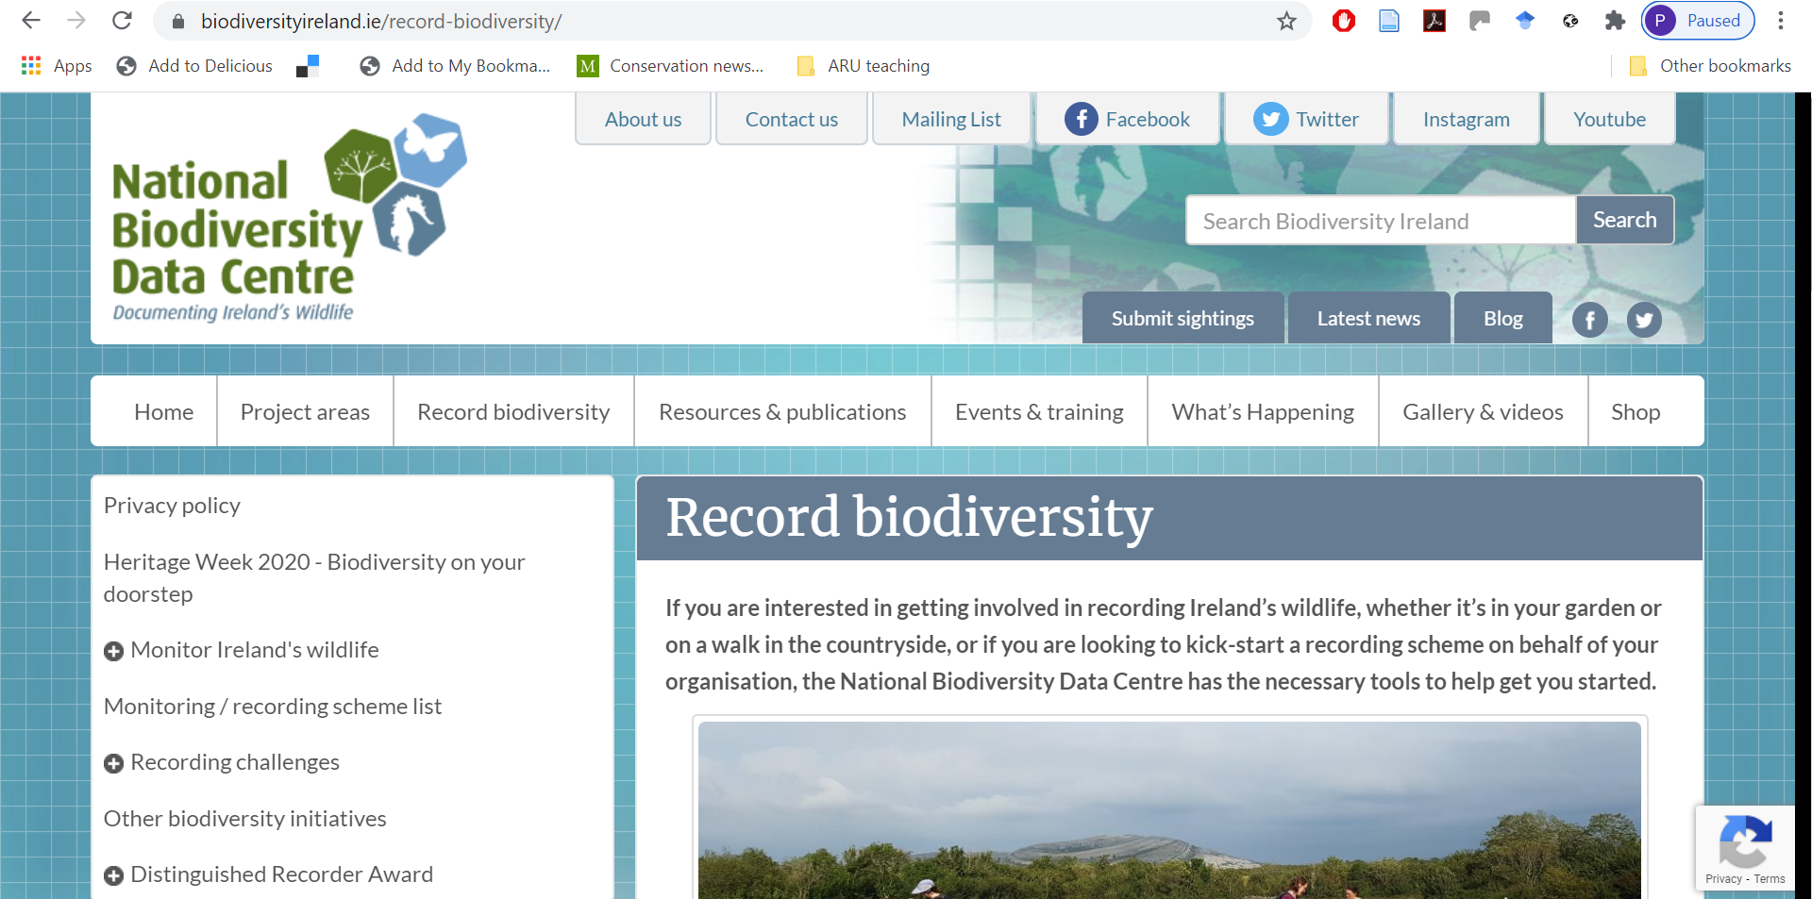
Ireland - www.biodiversityireland.ie/

Slide 15
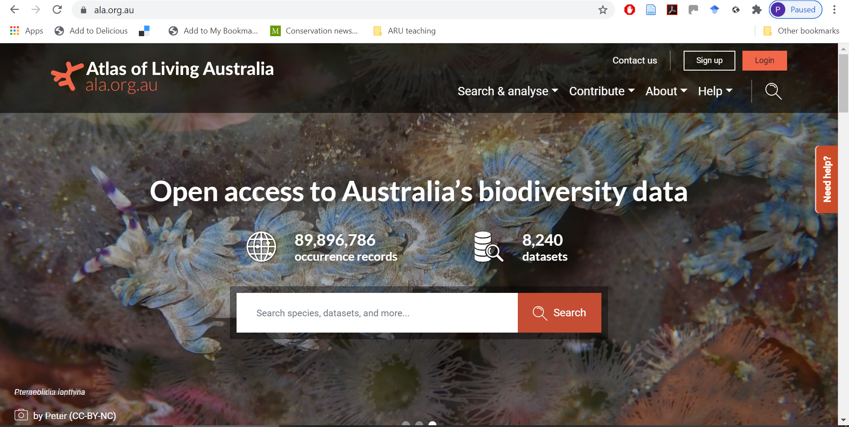
Australia - www.ala.org.au/

Slide 16
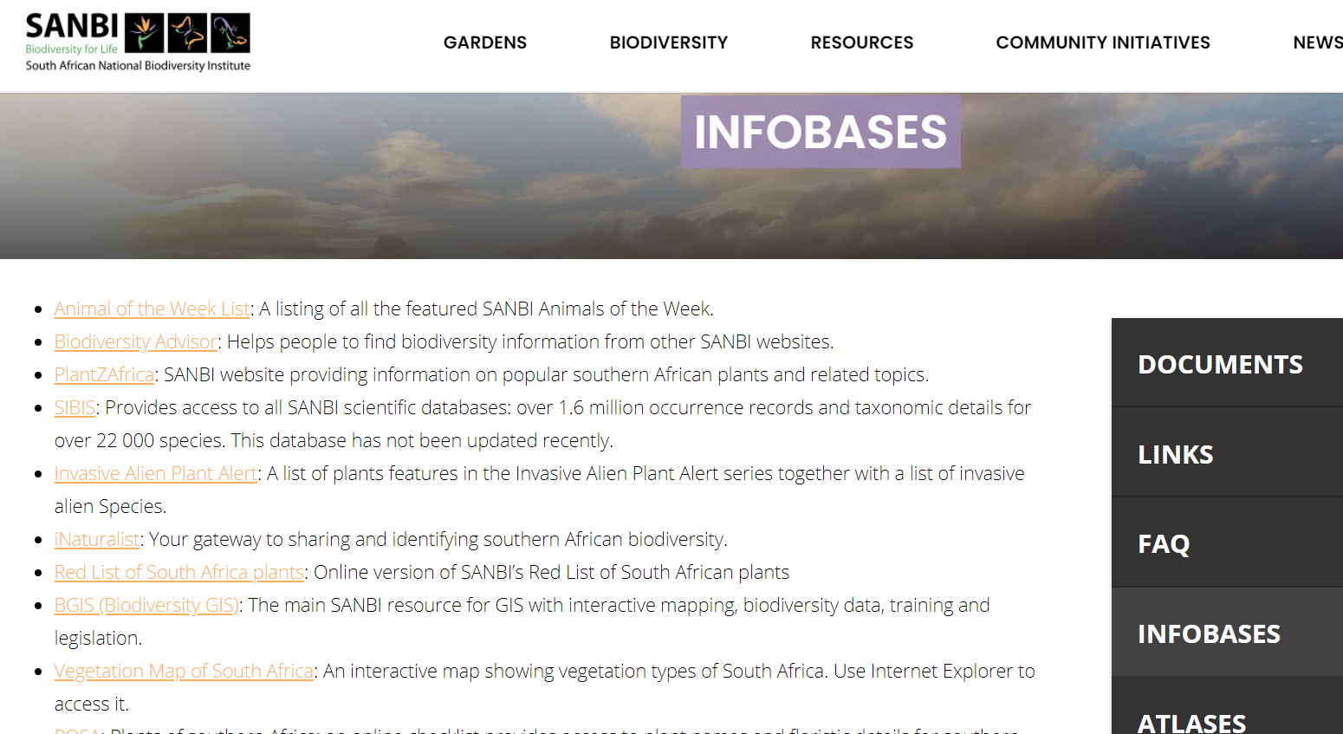
South Africa - www.sanbi.org/resources/infobases/

Slide 17
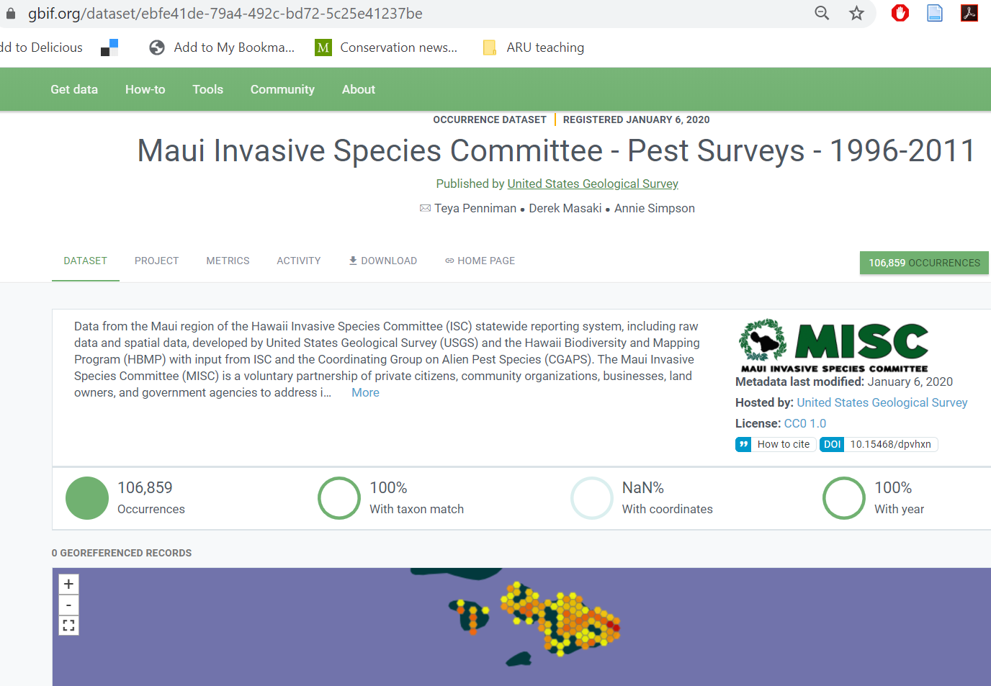
USA – via GBIF e.g. United States Geological Survey
USGS: major data provider on GBIF (>150 datasets)

Slide 18
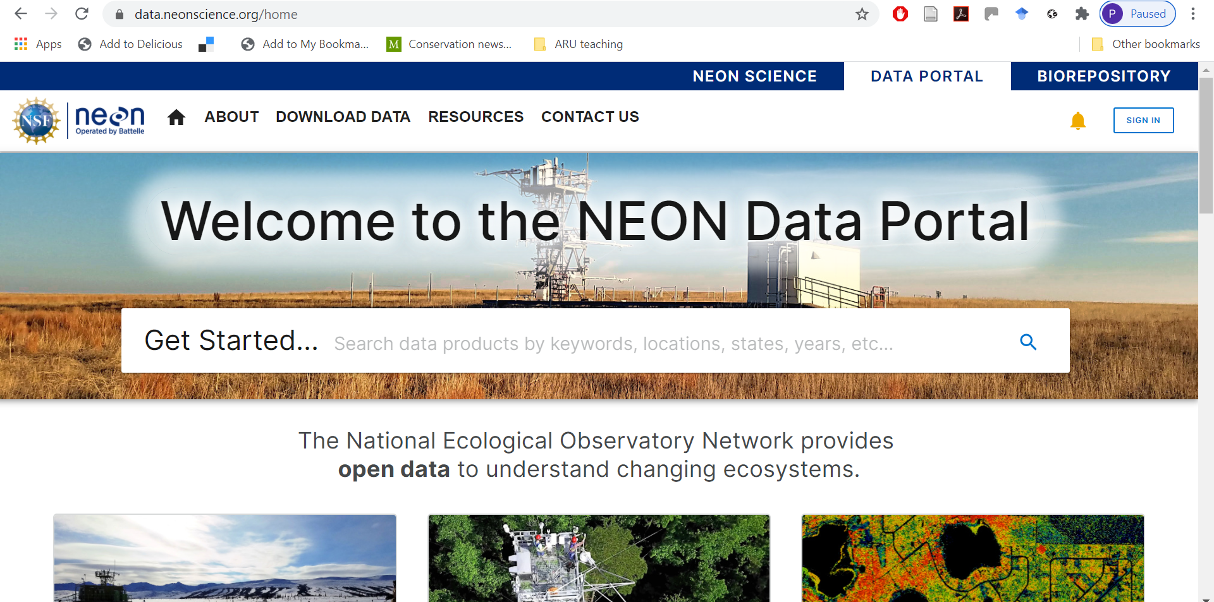
USA - https://data.neonscience.org/home
Notes:
https://data.neonscience.org/home

Slide 19
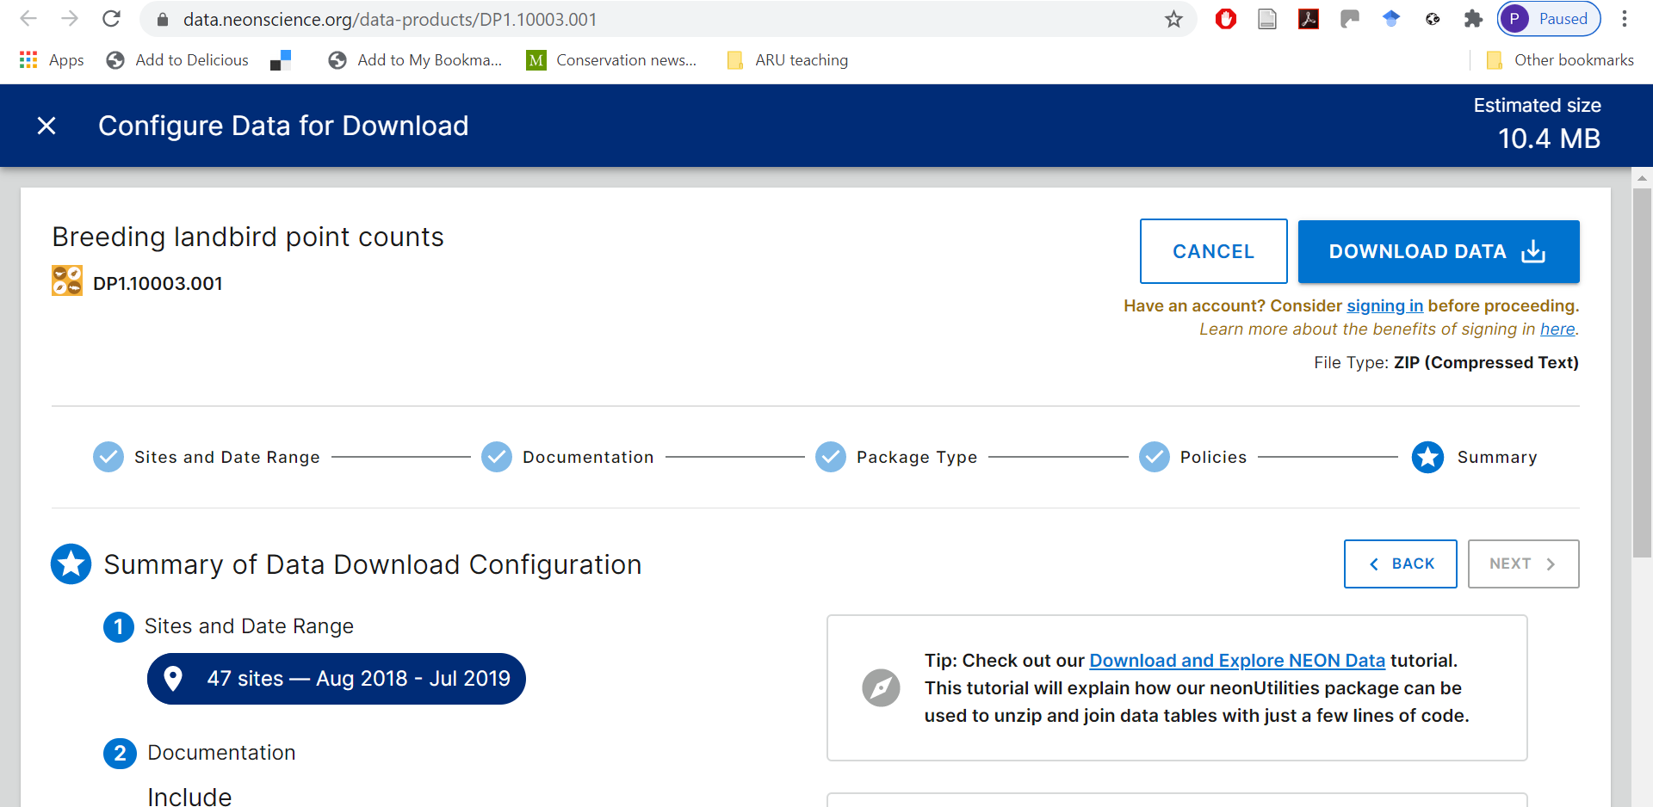
USA

Slide 20
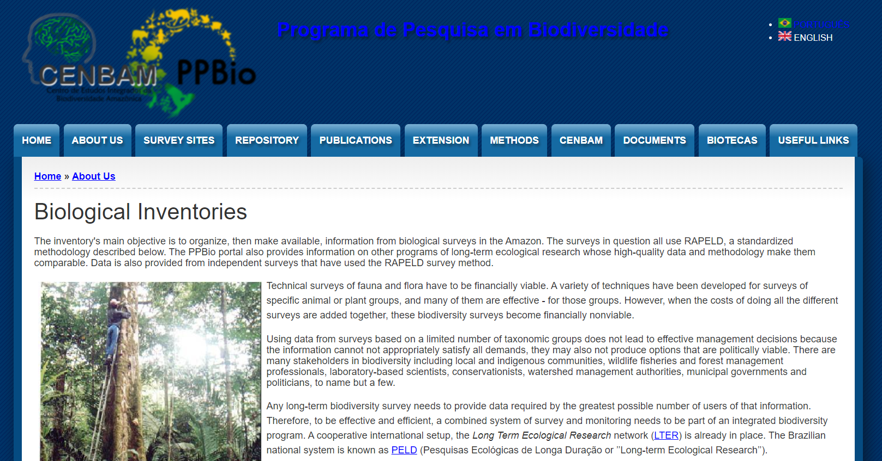
Brazil - https://ppbio.inpa.gov.br/en/Biological_Inventories

Slide 21
Other useful data sources

Slide 22
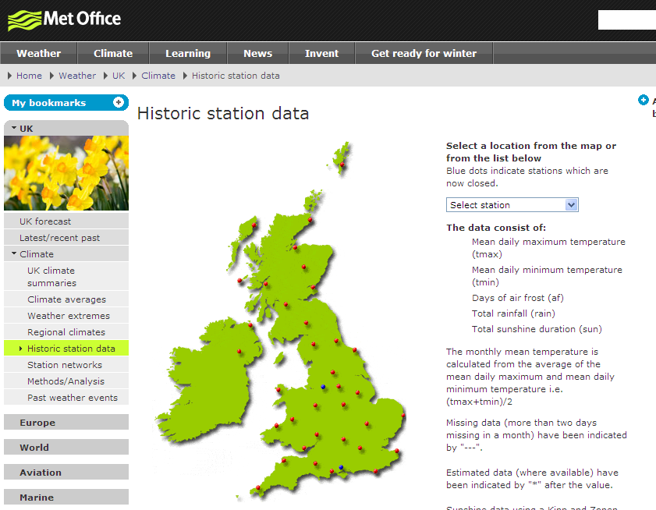
https://www.metoffice.gov.uk/services/data https://worldweather.wmo.int/en/home.html
Notes:
https://worldweather.wmo.int/en/home.html - has links to climate websites of other countries

Slide 23
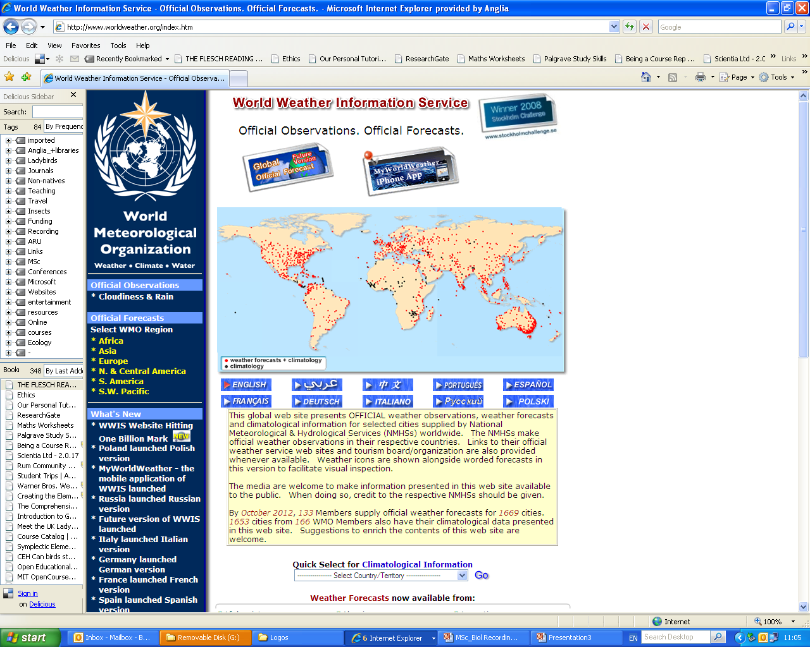
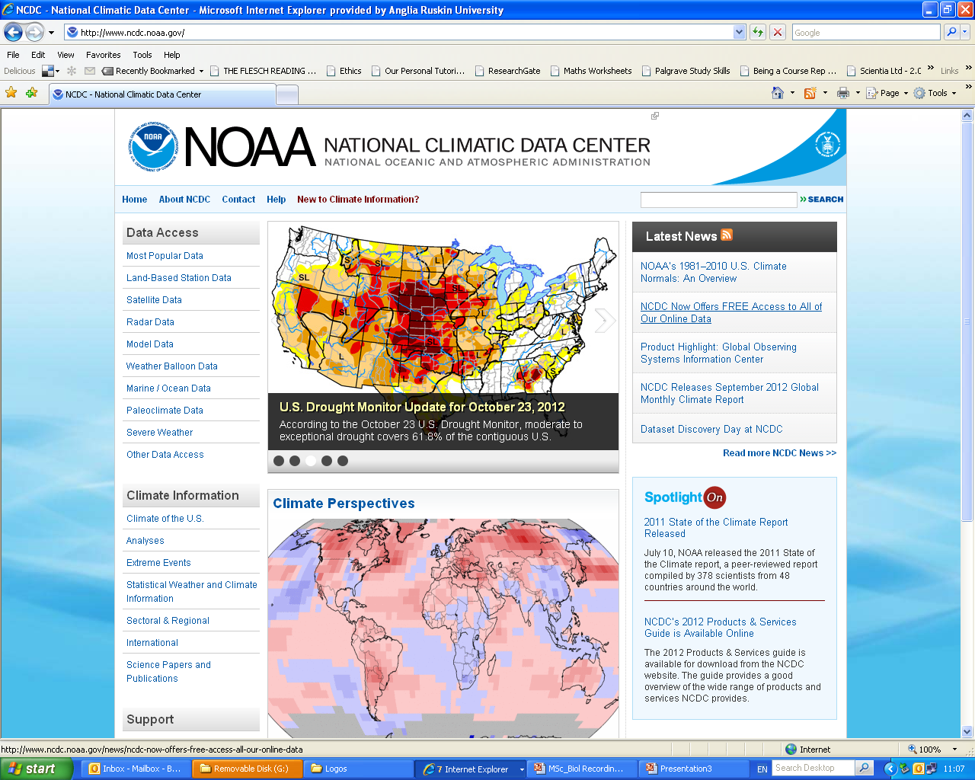
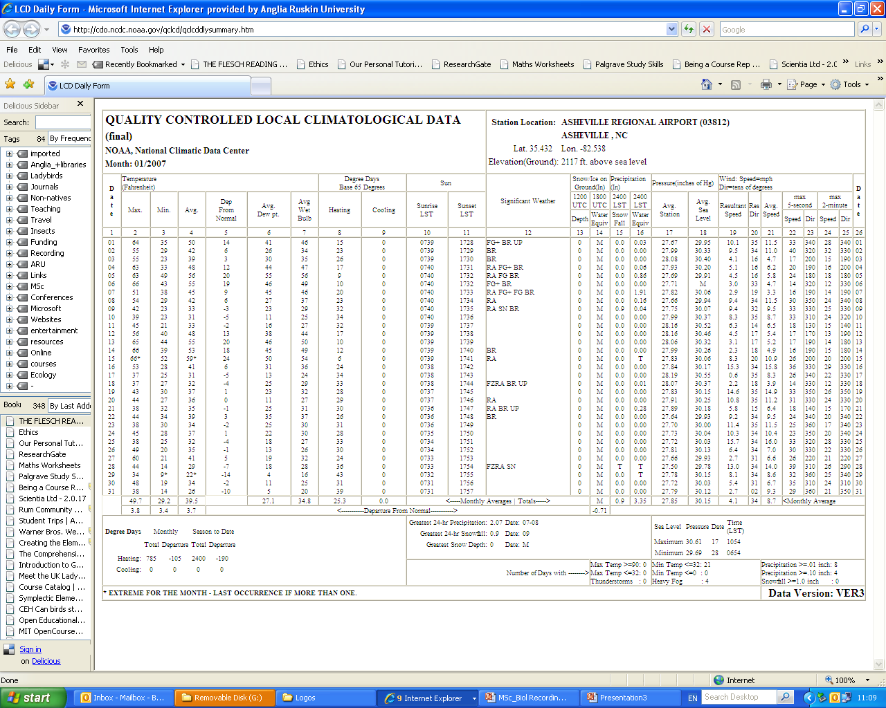

Slide 24
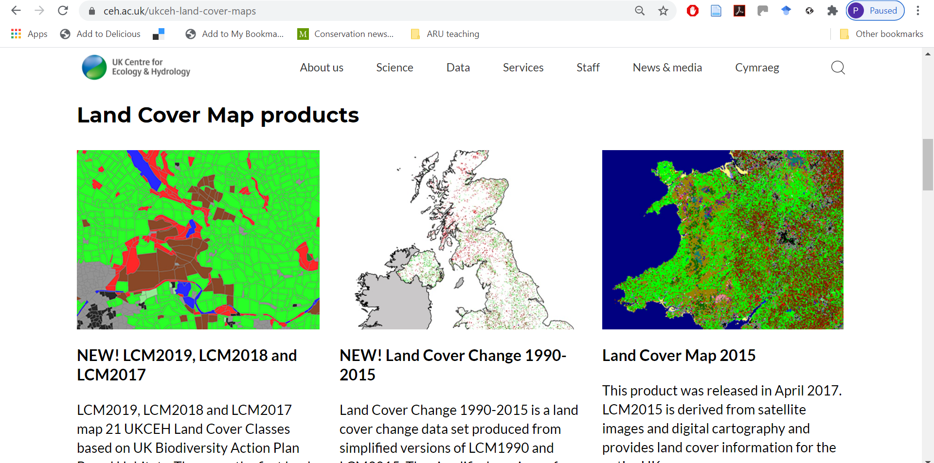
UK Land Cover Data www.ceh.ac.uk/ukceh-land-cover-maps
Notes:
https://www.ceh.ac.uk/ukceh-land-cover-maps

Slide 25
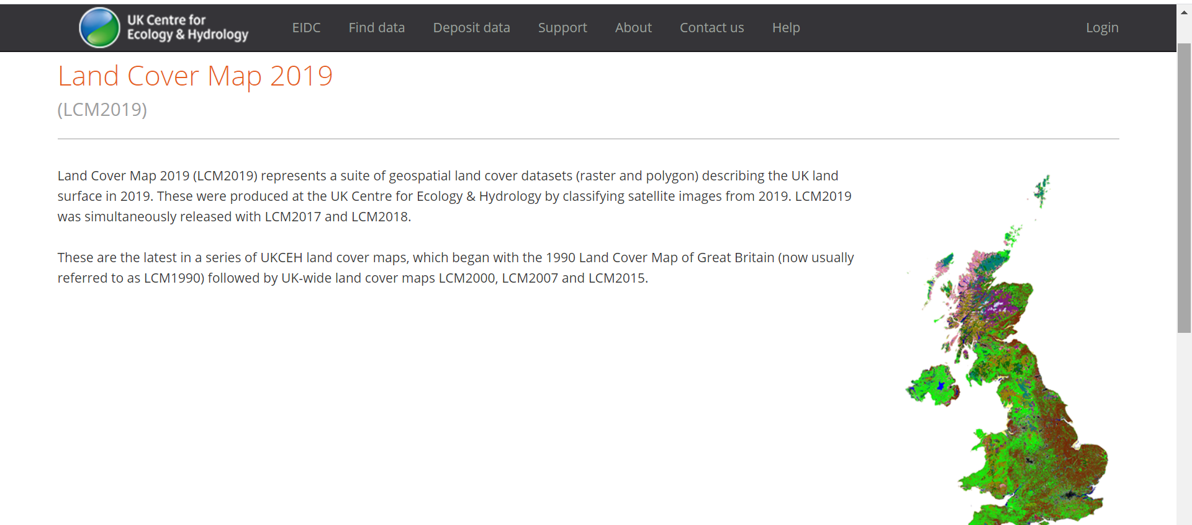
UK Land Cover Data www.ceh.ac.uk/ukceh-land-cover-maps

Slide 26
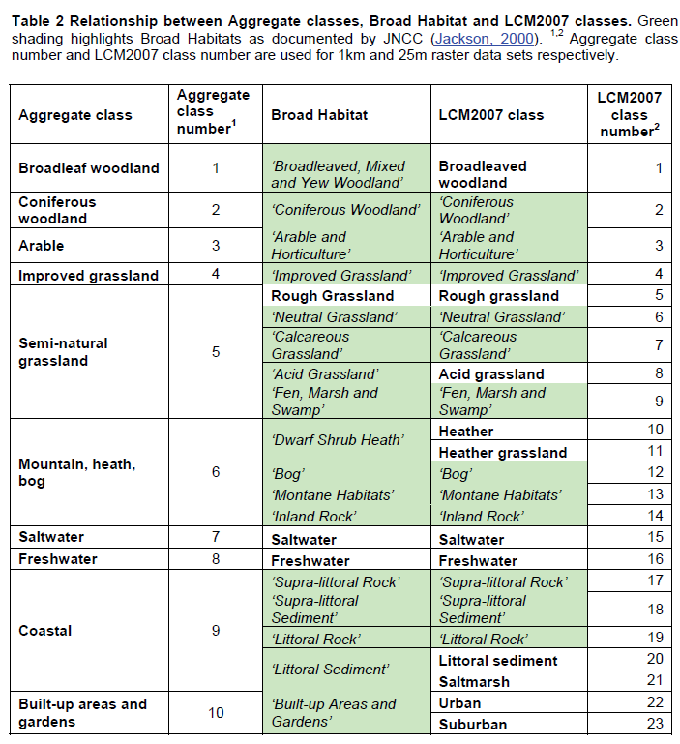
CEH
LAND COVER MAP 2015
https://gateway.ceh.ac.uk/home hundreds of other datasets here

Slide 27
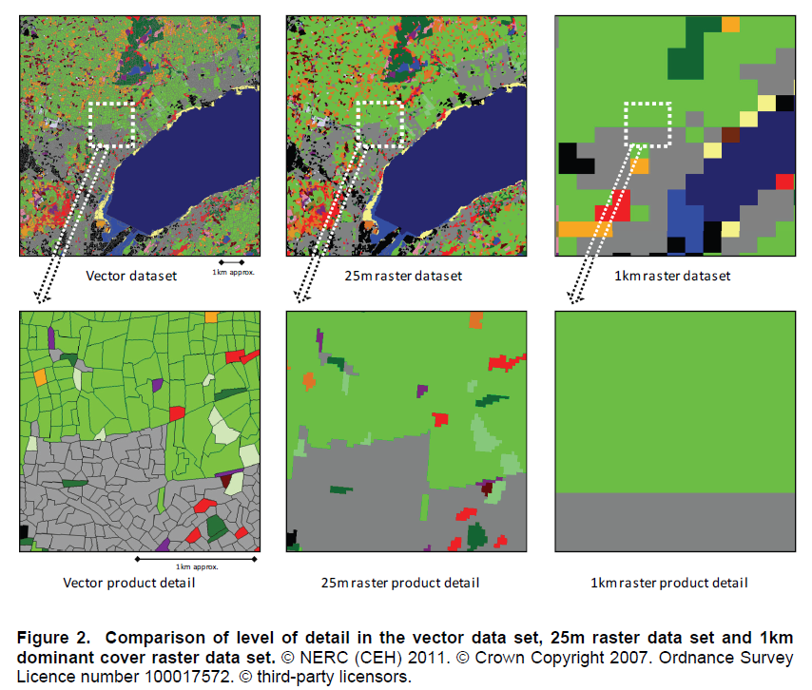
CEH
LAND COVER MAP 2015

Slide 28
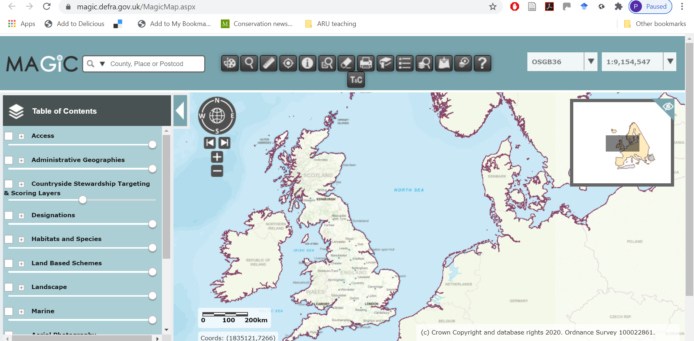
MAGIC https://magic.defra.gov.uk/MagicMap.aspx

Slide 29
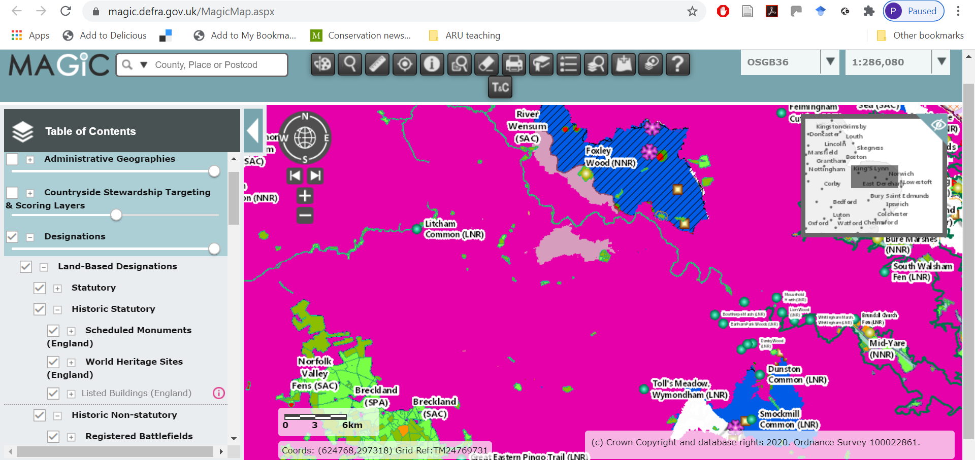
MAGIC https://magic.defra.gov.uk/MagicMap.aspx

Slide 30
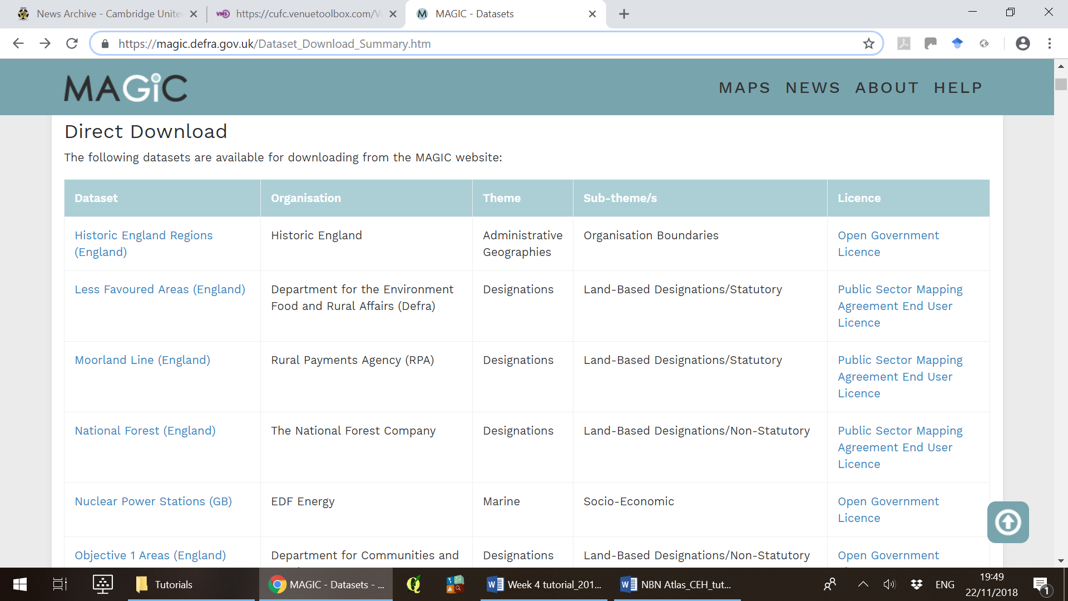
MAGIC https://magic.defra.gov.uk/Dataset_Download_Summary.htm

Slide 31
Citizen Science 2 - Data
Part i
NBN Atlas
GBIF
Part ii
Country-based biodiversity portals
Other useful data sources
Part iii
Global citizen science projects
Research from citizen science

Slide 32
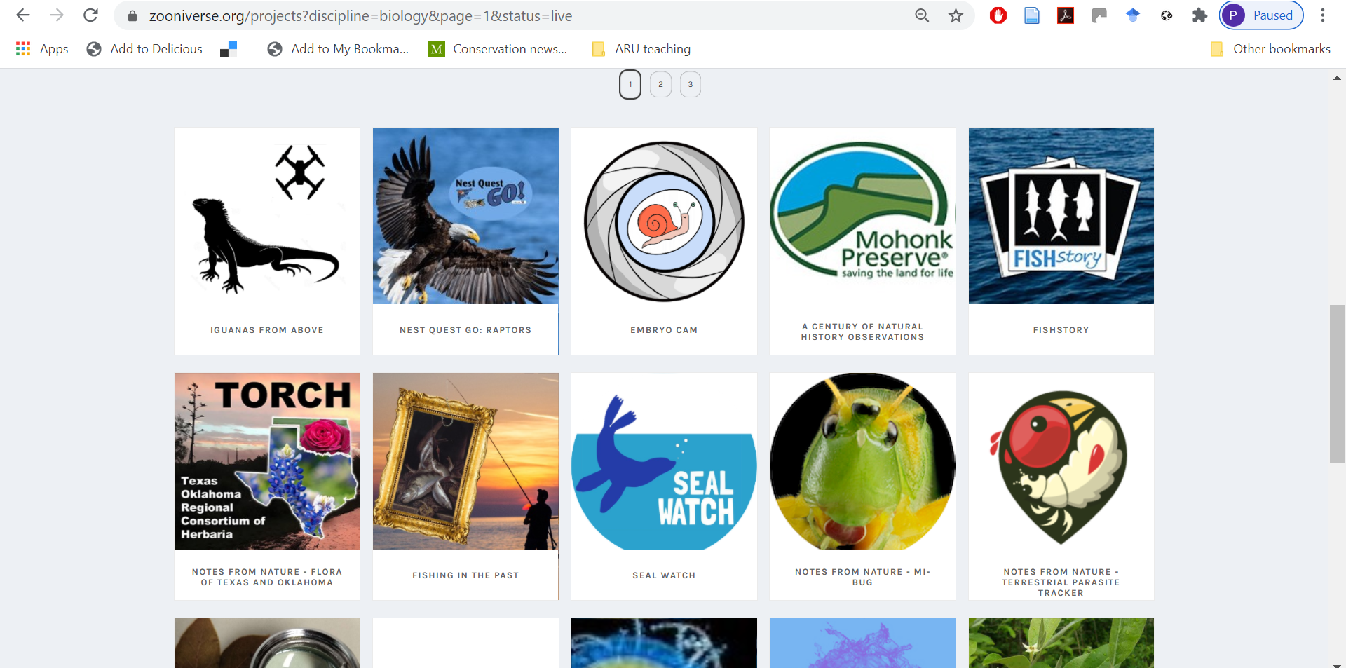
Zooniverse
Notes:
https://www.zooniverse.org/projects?discipline=biology&page=1&status=live

Slide 33
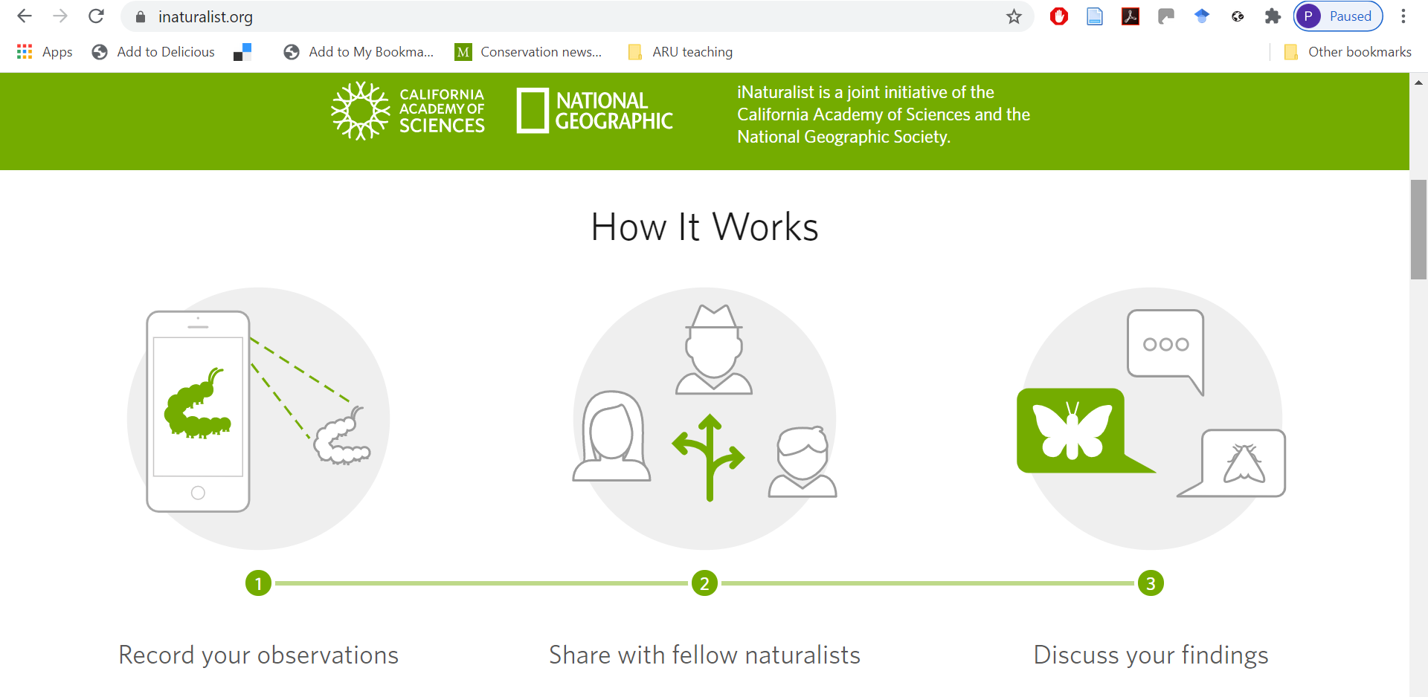
iNaturalist
Notes:
https://www.inaturalist.org/

Slide 34
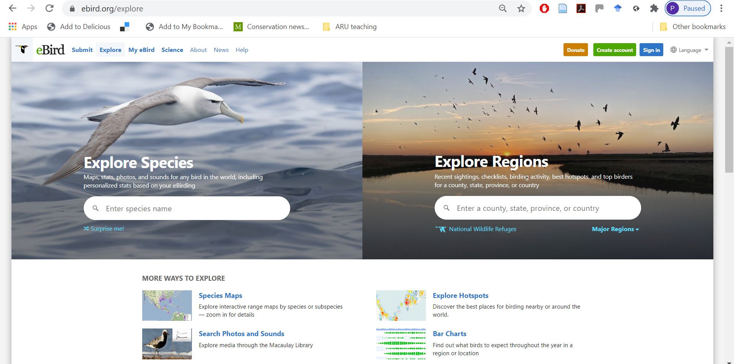
eBird
US-based (Cornell Ornithology Lab)
Notes:
https://ebird.org/about

Slide 35
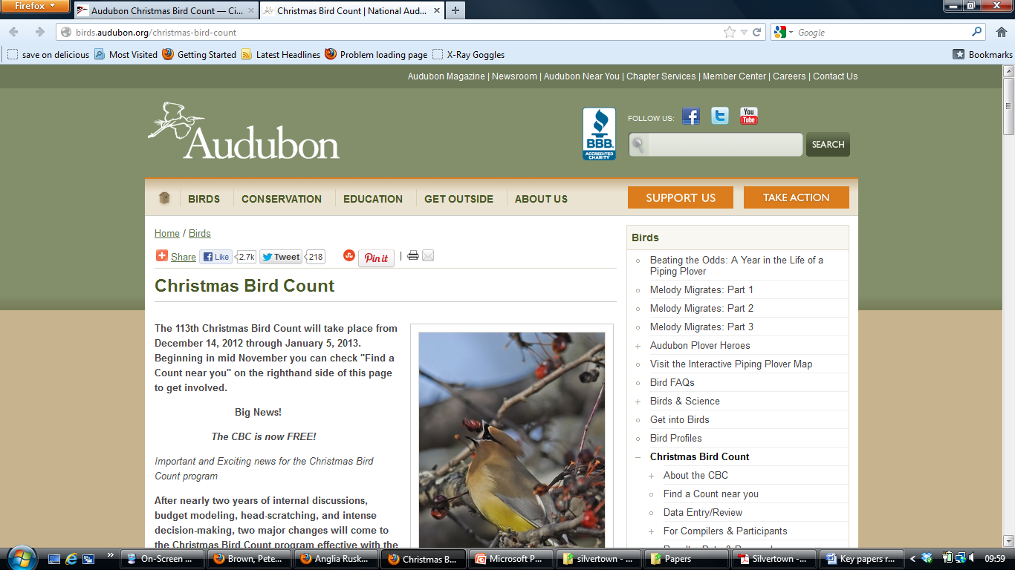
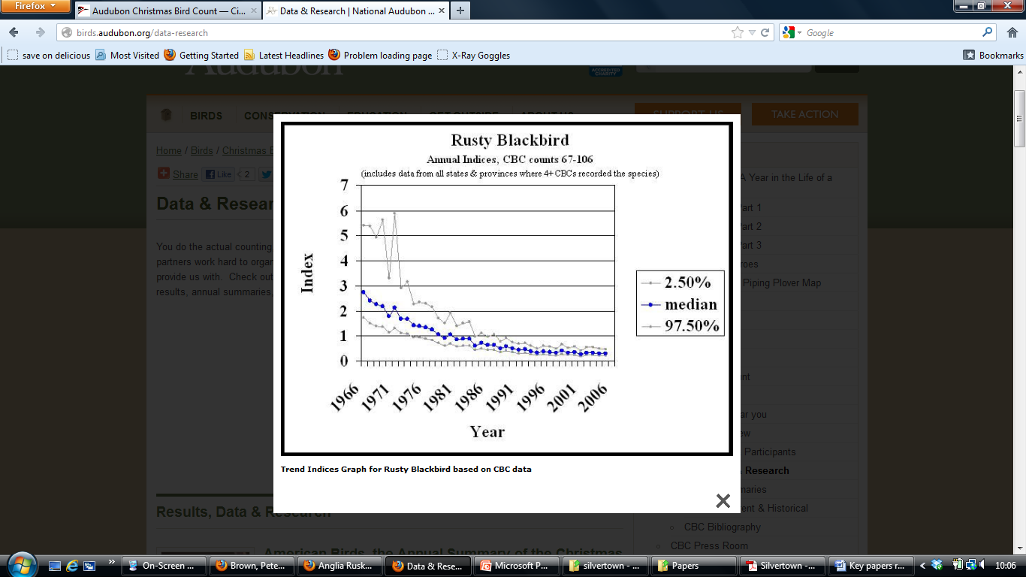
Citizen science around the world – USA
Audubon Christmas Bird Count started 1900
350 papers and reports from the dataset
40 year population trends of 20 common species
reduced by average of 68%

Slide 36
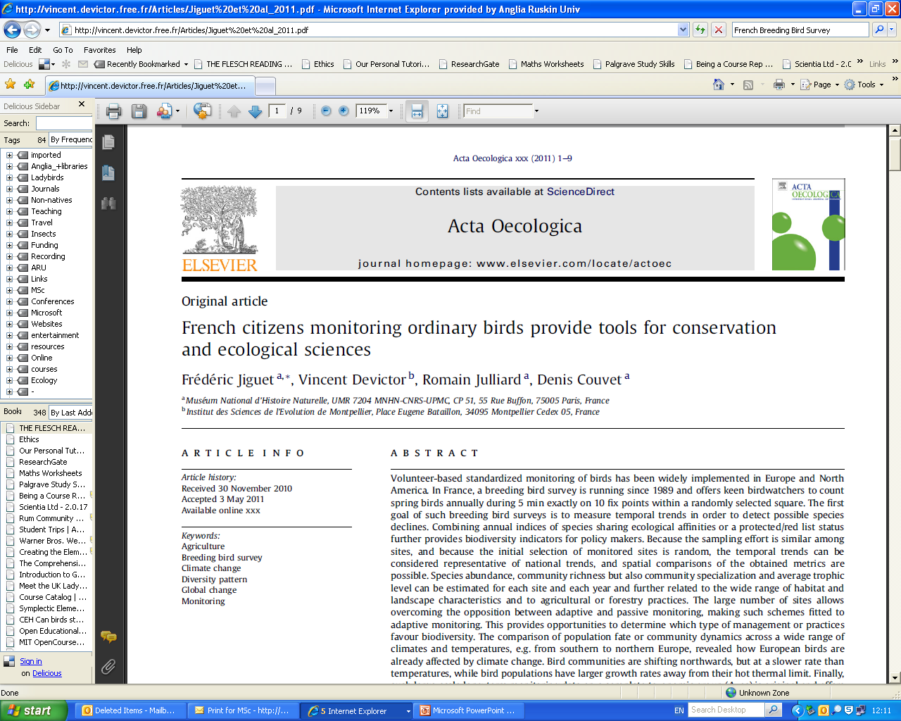
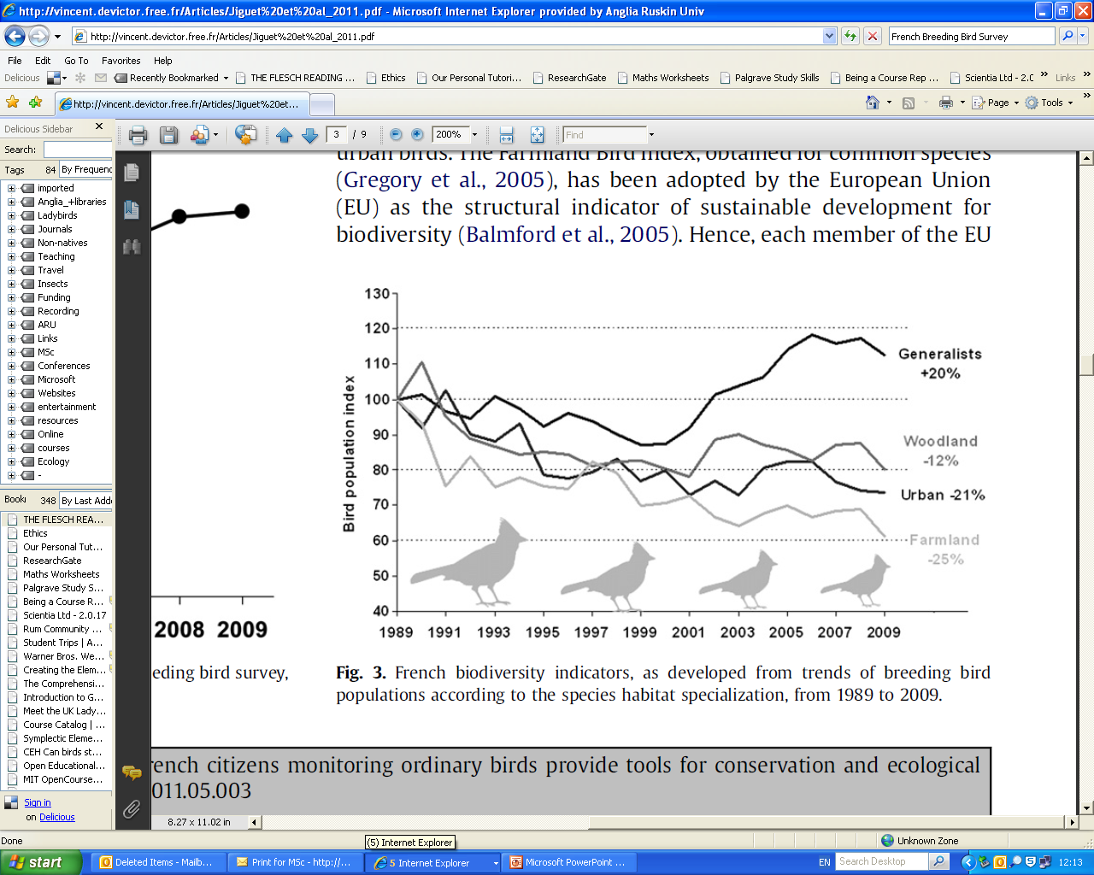
Citizen science around the world – France
Acta Oecologica 2012
44: 58–66

Slide 37
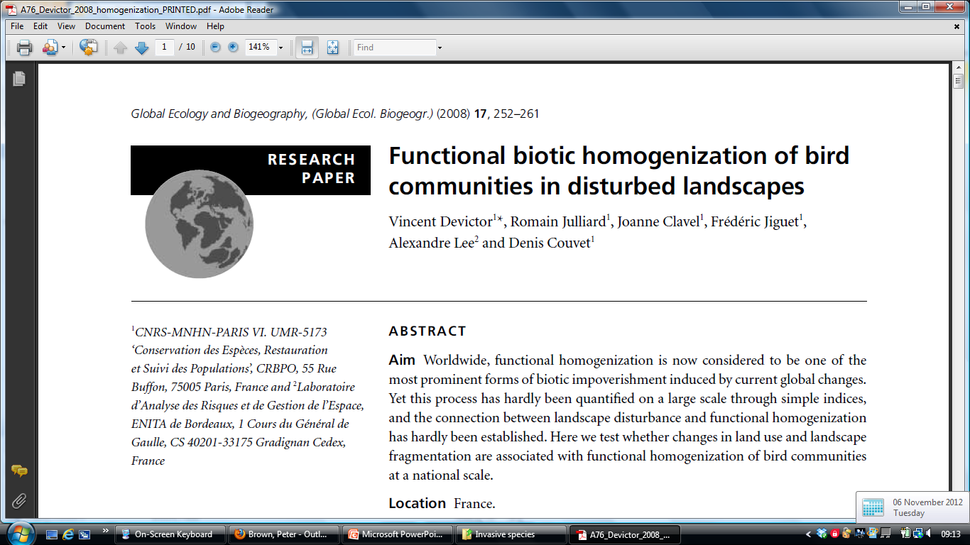
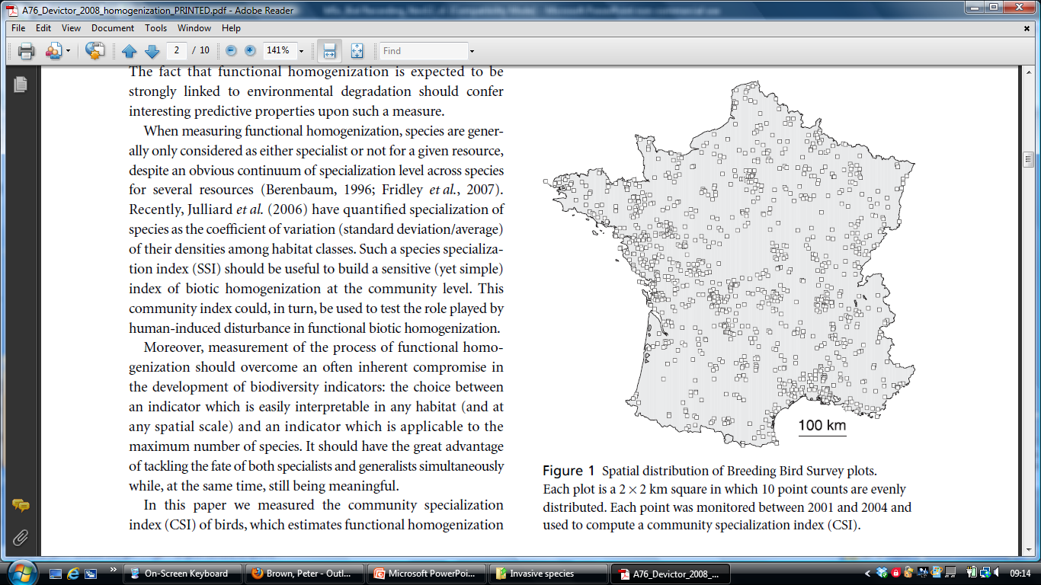
Citizen science around the world – France

Slide 38
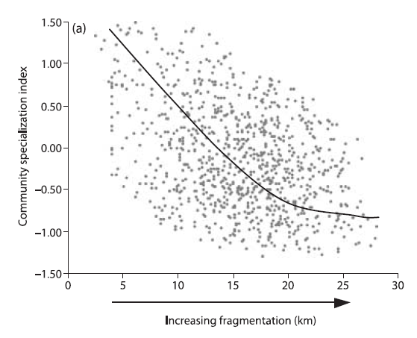
Citizen science around the world – France

Slide 39
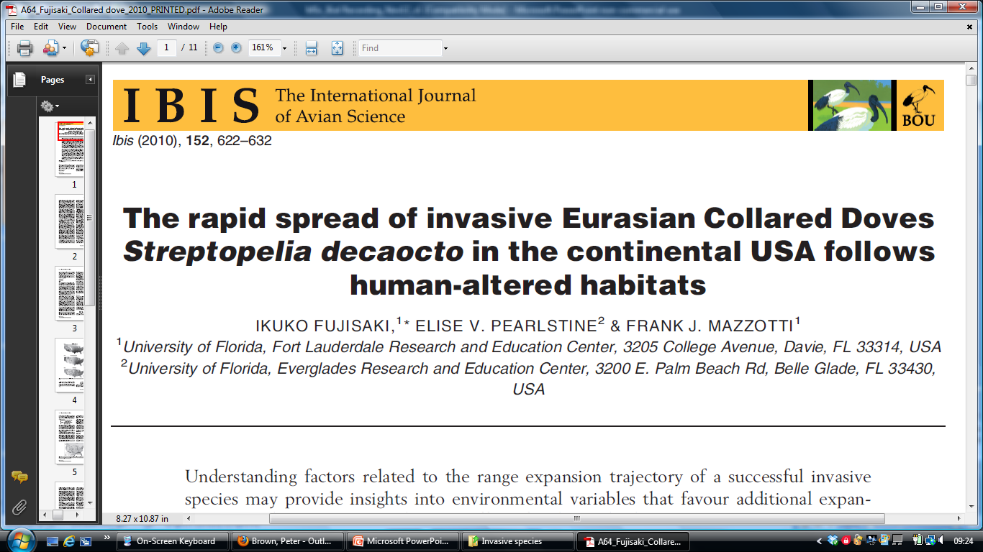

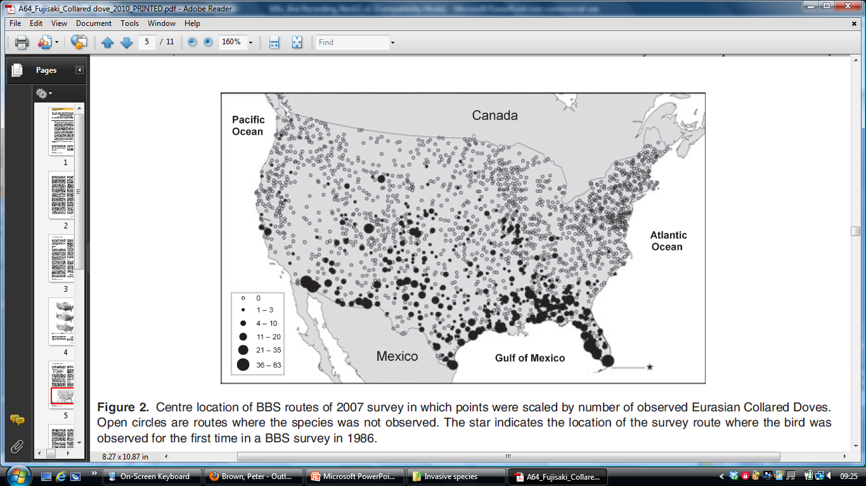
Citizen science around the world – USA

Slide 40
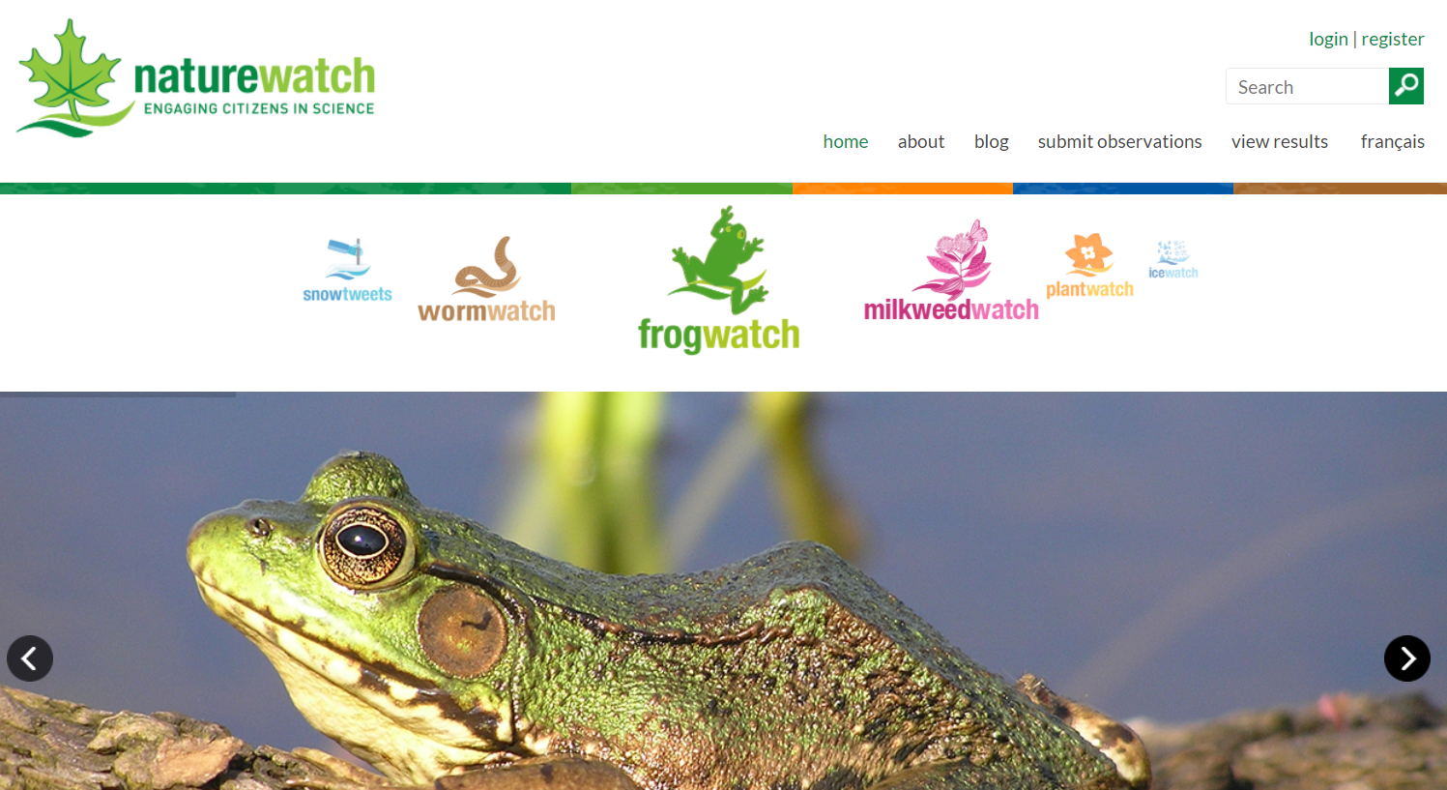
Other examples of citizen science around the world – Canada
Notes:
Nature Watch Canada: http://www.naturewatch.ca/english/select_province.html

Slide 41
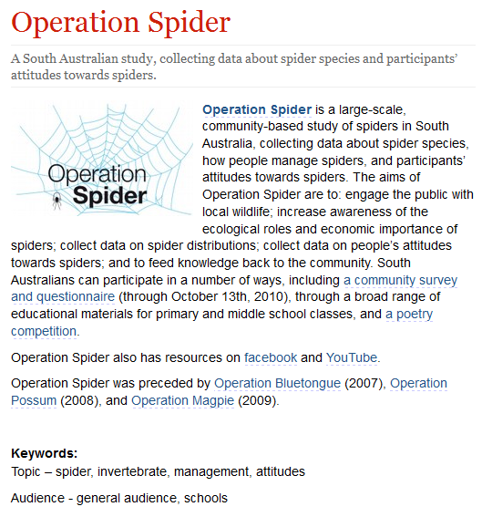
Citizen science around the world – Australia
Notes:
From http://www.birds.cornell.edu/citscitoolkit/projects/barbarahardy/spider/
Operation Spider is a large-scale, community-based study of spiders in South Australia, collecting data about spider species, how people manage spiders, and participants’ attitudes towards spiders. The aims of Operation Spider are to: engage the public with local wildlife; increase awareness of the ecological roles and economic importance of spiders; collect data on spider distributions; collect data on people’s attitudes towards spiders; and to feed knowledge back to the community. South Australians can participate in a number of ways, including a community survey and questionnaire (through October 13th, 2010), through a broad range of educational materials for primary and middle school classes, and a poetry competition.
Operation Spider also has resources on facebook and YouTube.
Operation Spider was preceded by Operation Bluetongue (2007), Operation Possum (2008), and Operation Magpie (2009).

Slide 42
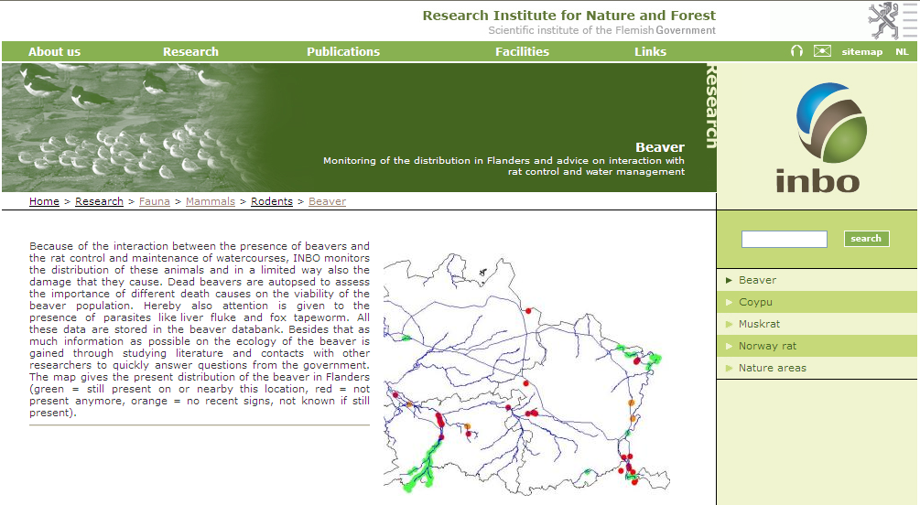
Other examples of citizen science around the world – Belgium
Notes:
42

Slide 43
References
Recording / data
UK: www.nbn.org.uk
UK: www.brc.ac.uk
Global: www.gbif.org
Citizen science
www.opalexplorenature.org
Links to many citizen science projects - www.birds.cornell.edu/citscitoolkit
August, T., et al. 2015. Emerging technologies for biological recording. Biol. J. Linnean Soc. DOI: 10.1111/bij.12534.
Miller-Rushing, A., et al. 2012. The history of public participation in ecological research. Frontiers in Ecology and the Environment 10(6): 285-290.
Roy, H.E., et al. 2015. The contribution of volunteer recorders to our understanding of biological invasions. Biol. J. Linnean Soc. DOI: 10.1111/bij.12518.
Climate data
UK: https://www.metoffice.gov.uk/services/data
Global: www.worldweather.org
USA: https://www.ncdc.noaa.gov/cdo-web/
Land Cover
UK: https://www.ceh.ac.uk/services/land-cover-map-2015
Notes:
43

